Slide 1
Hate Speech Detection
Guided By:
Prof Quazi Rahman
DhyanKumar Shah (1131707)
Shruti Govani (1143388)

Slide 2
Introduction
Hate speech is described as any form of communication that is abusive, insulting, intimidating, and/or in- cites violence or prejudice against an individual or a vulnerable group based on characteristics such as ethnicity, gender, sexual orientation, or religion.
Several techniques and approaches have been introduced for an automatic detection of such contents using Artificial Intelligence and Natural language processing.
However, Text classification, on the other hand, has a lot of data imbalance problems. The problem of an unbalanced dataset occurs when data from one class is considerably greater or lower than data from other classes.
Data augmentation is a technique that can help generate a large amount of data from a small amount.
Here, we experimented various data augmentation techniques such as Back Translation, EDA and Bert Contextual embeddings.

Slide 3
Data Pipeline

Slide 4
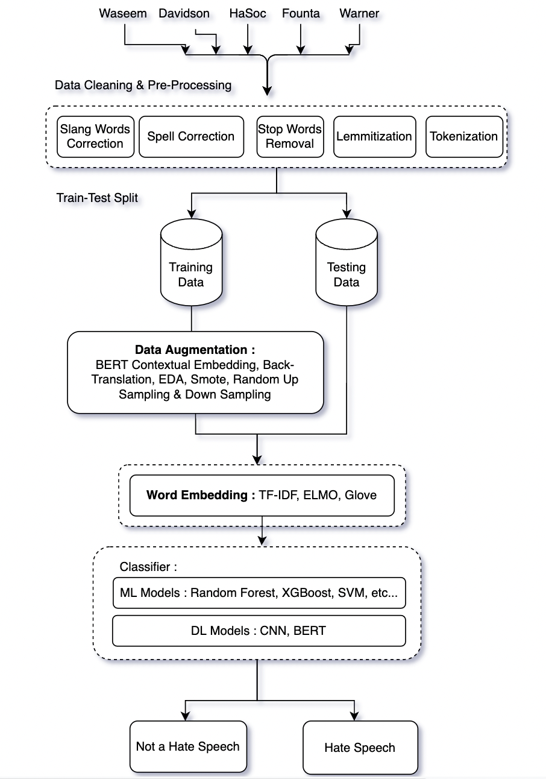

Slide 5
Dataset
Name of the Dataset | Total | Hate | Non-Hate
Warner (14.65% - 85.34%) | 1269 | 186 | 1085
Waseem (3.49% - 96.5%) | 14142 | 494 | 13648
Founta (14.21% - 85.7%) | 59319 | 8434 | 50885
Hasoc (50% - 50%) | 3708 | 1856 | 1852
Davidson (5.77% - 94.22%) | 24783 | 1430 | 23353
Total (12.01% - 87.9%) | 103221 | 12400 | 90823

Slide 6
Data Cleaning and Preprocessing
Preprocessing using Regular Expression: Using Regular Expression we removed hashtags, video and audio tags, mentions, unnecessary spaces, digits from the tweets.
Stop words removal: Stop words are words such as a, an, the,is, as,has etc. Most of the the time they add noise and thus removing it is necessary.
Spell Correction: In this step, we detected and corrected spelling errors from the tweets using Autocorrect library.
Contraction Map (Expansion of Short Forms): In English contractions, we often drop vowels from a word to form the contractions. For example, I’ll be there in 2 mins. Are u not gng there? I’d like to see u near d park. However, Removing contractions contributes to text standardization and is useful when working on twitter data , or on reviews as the words play an important role. Here, we created our own contraction map dictionary for this purpose.
Lemmatization/stemming: We perform lemmatization/ stemming using NLTK library to identify and return the root words of sentence to explore various additional information from the dataset.
Tokenization: After Lemmatization, we broke the dataset into words, punctuation marks, numeric digits using Tokenization. The most popular method for creating tokens is to use space. Using space as a delimiter, the tokenization of the text produces the text produces three tokens. For example for Natural language processing .After the tokenization will get Natural-language-processing.

Slide 7
Word Embedding Techniques

Slide 8
TF-IDF Vectorizer
tf is the number of times a term appears in a particular document. So it’s specific to a document
tf(t) = (No. of times term ‘t’ occurs in a document) / (No. Of terms in a document)
idf is a measure of how common or rare a term is across the entire corpus of documents. So the point to note is that it’s common to all the documents. If the word is common and appears in many documents, the idf value (normalized) will approach 0 or else approach 1 if it’s rare.
idf (t) =1 + log e [ n / df(t) ]
Formula = tf(t) * idf(t)

Slide 9
GLOVE Embedding
Word embedding is a way where in each word in the text is represented by a vector with real values in a high dimensional space. The vectors are learned such that similar representation will be present for words that have similar meanings in the vector space.
Glove is a semantic vector models of language represent each word with a real valued vector.
GloVe embeddings were trained on a dataset of one billion words with a vocabulary of 400 thousand words. There are few different embedding vector sizes such as 50, 100, 200 and 300 dimensions.
Glove model uses word frequency and global co-occurrence count matrix.
Count-based models learn their vectors by essentially doing dimensionality reduction on the co-occurrence counts matrix.
These vectors can be used as features in a variety of applications such as information retrieval, document classification, question answering , NER (Named entity recogni and parsing.

Slide 10
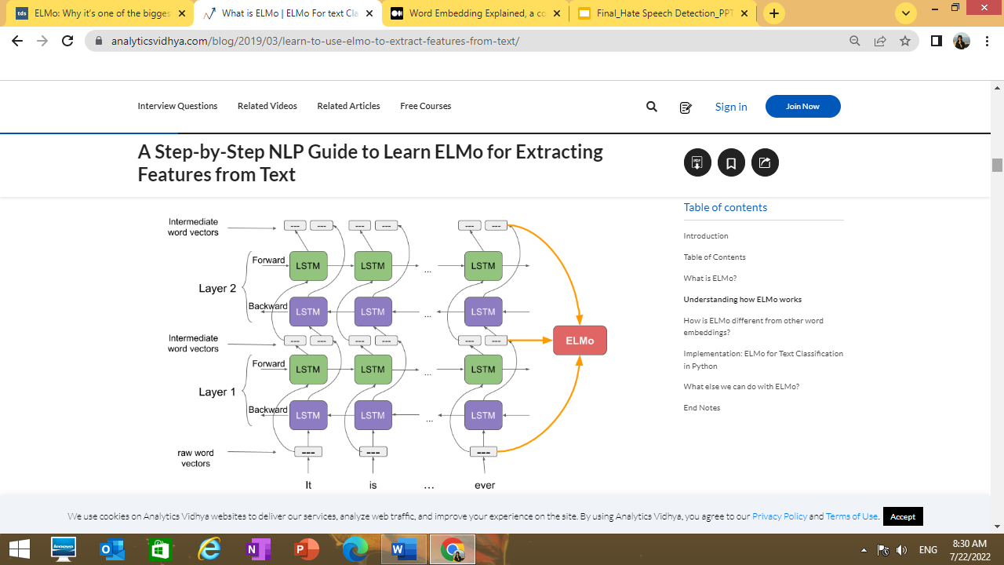
ELMO Embedding
ELMo stands for Embeddings from Language Models, and hence it also has the ability to predict the next word in a sentence.
It is a way of representing a deep contextualized word that models both complex characteristics of word use, and how these uses vary across linguistic contexts.
So, Instead of using a fixed embedding for each word, like models like GloVe do , ELMo looks at the entire sentence before assigning each word in it its embedding.
Elmo uses bi-directional LSTM in training, so that its language model not only understands the next word, but also the previous word in the sentence. It contains a 2-layer bidirectional LSTM backbone. The residual connection is added between the first and second layers.

Slide 11
Data Augmentation Techniques

Slide 12
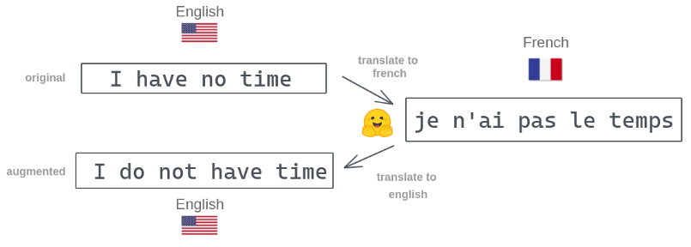
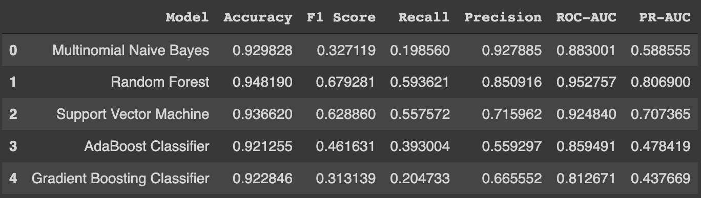
Back Translation
The back translation concept is straightforward and consists of three main steps.
Temporary translation: translate each of the original training labeled data into a different language. In our case, it will be from English to French.
Back translation: translate back each of those translated data into the original language, meaning a translation from French to English.
Duplicate removal: at the end of the process, we will have for each original text data, its corresponding back-translation. The goal here is to keep only one occurrence of each duplicate.

Slide 13
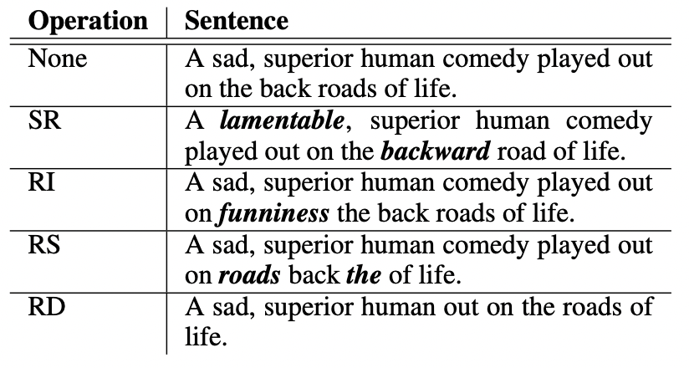
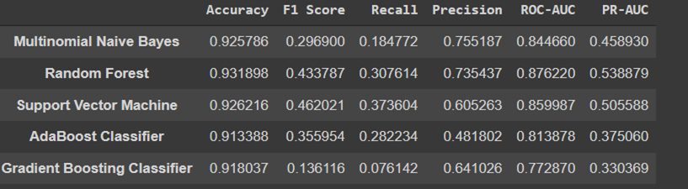
EDA
Synonym Replacement (SR): Select n non-stop words at random from the phrase. Each of these words should be swapped out with a random synonym.
Random Insertion (RI): Locate a random synonym for a random word that isn't a stop word in the phrase. Put that antonym in any arbitrary part of the text. Repeat this n times.
Random Swap: Switch the locations of two randomly selected words in the phrase repeat this n times.
Random Deletion (RD): Using probability p, randomly eliminate each word from the phrase.

Slide 14
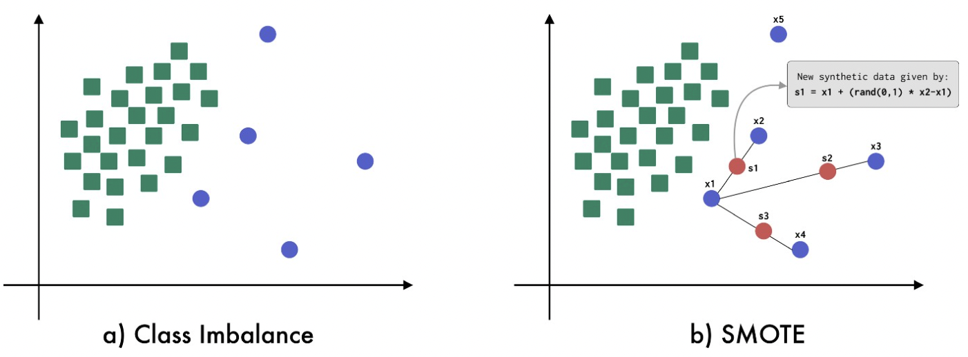
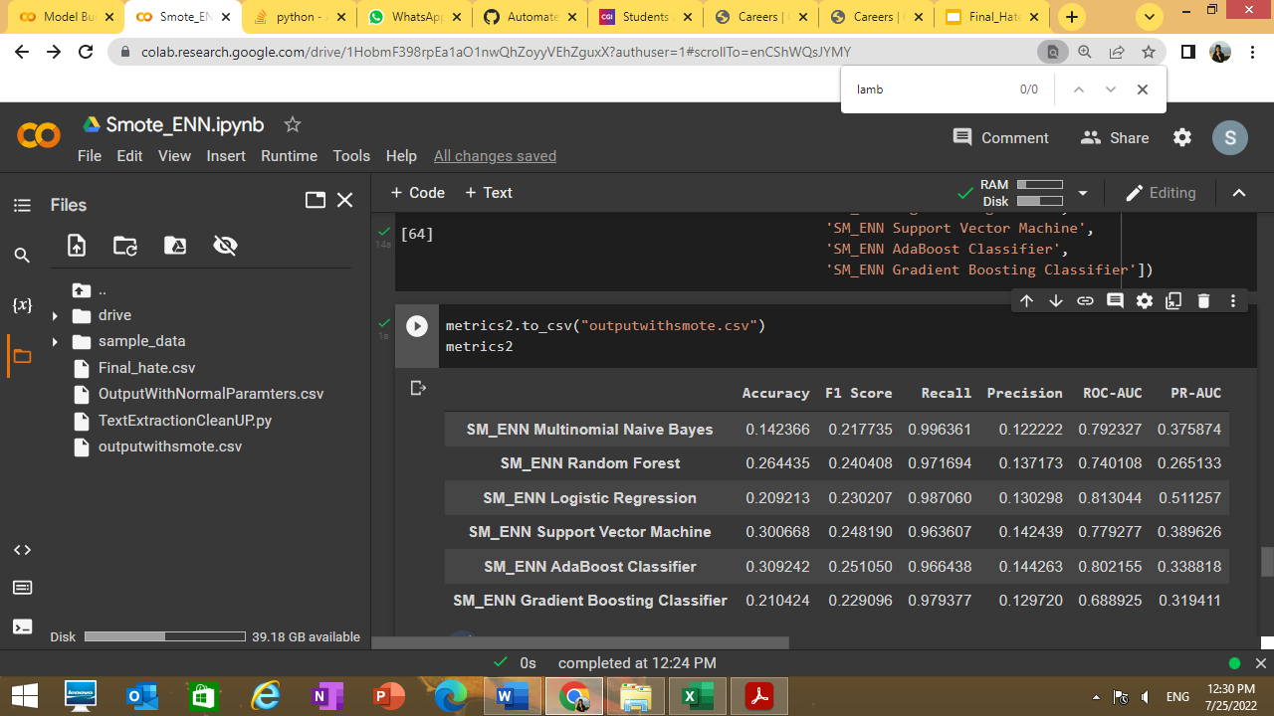
SMOTE-ENN (Edited Nearest Neighbor)
This method combines the SMOTE ability to generate synthetic examples for minority class and ENN ability to delete some observations from both classes that are identified as having different class between the observation’s class and its K-nearest neighbor majority class.
Choose random data from the minority class.
Calculate the distance between the random data and its k nearest neighbors.
Multiply the difference with a random number between 0 and 1, then add the result to the minority class as a synthetic sample.

Slide 15
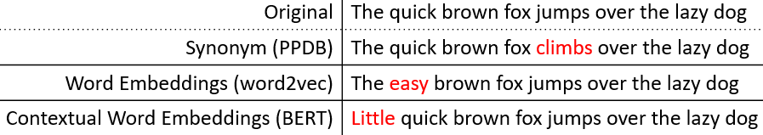
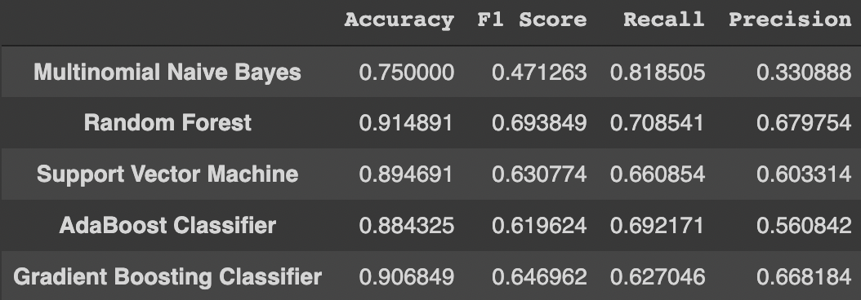
BERT Contextual Embedding
We assume an invariance that sentences are natural even if the words in the sentences are replaced with other words with paradigmatic relations.
At the word places, we stochastically swap out words with others that a bidirectional language model predicts. There are many context-sensitive terms, but they are all acceptable for enhancing the original language.

Slide 16
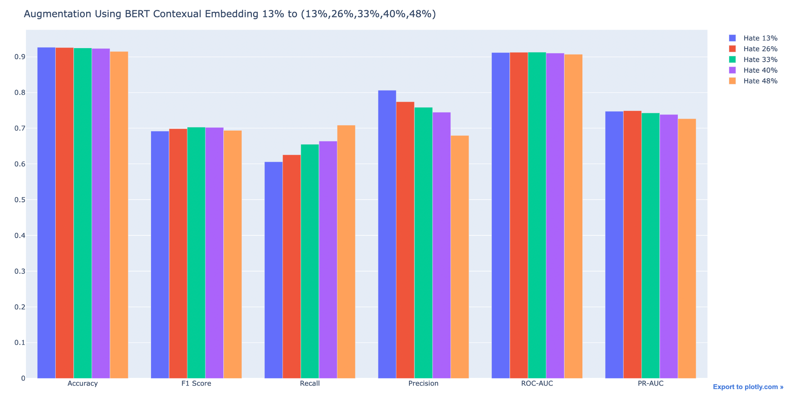
Link : https://plotly.com/~dhyan1999/1/

Slide 17
Models

Slide 18
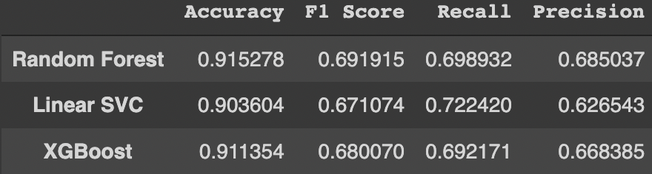
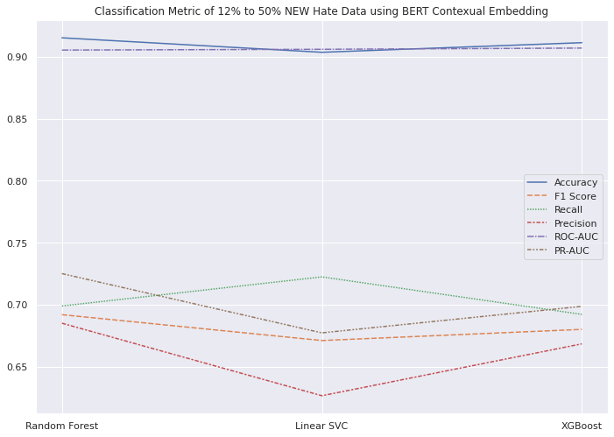
Machine Learning Models
Random Forest :
Hyperparameters Used : n_estimators = 100, criterion = 'gini'
XGBoost :
Hyperparameters Used : n_estimators = 1500, eta = 0.05
LinearSVC
Hyperparameters Used : C = 0.028, multi_class = "crammer_singer", max_iter = 1000
Best Model : Random Forest

Slide 19
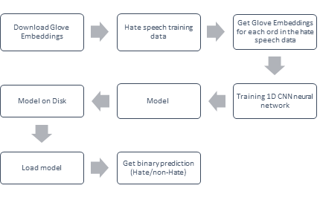
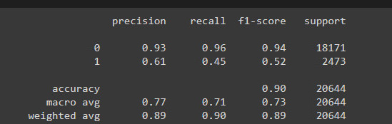
Deep Learning Models
CNN + Glove : CNN has traditionally been used to identify objects within images. With the help of word embeddings, it can also be extended for text classification.
Just like in traditional CNN, lower level layers helps in identifying edges, parts of bigger objects and successive layers identifies objects,in the case of text classification, the lower layer attempted to find associations between words, whereas the higher layer attempted to find associations between groups of words. These groups can be sentences, paragraphs, or smaller subgroups.
A typical process for classifying a Hate Speech dataset require multiple steps outlined below.

Slide 20
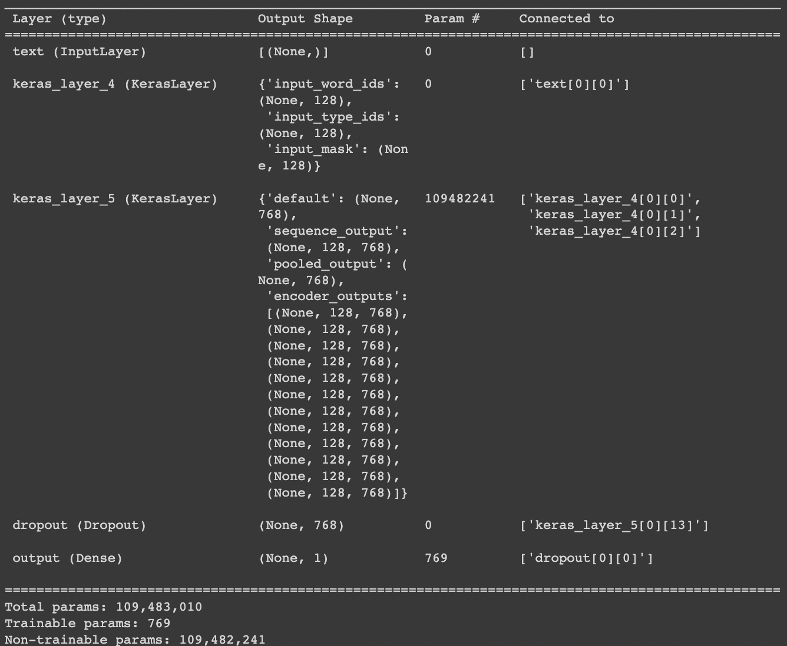
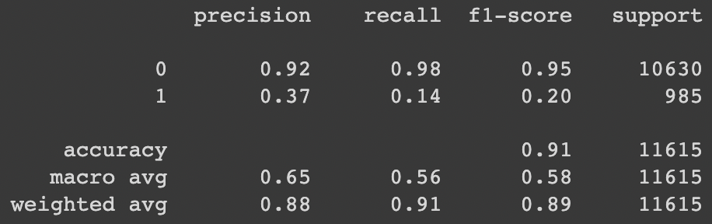
2. BERT T5 :
Bidirectional Encoder Representations from Transformers is denoted as BERT.
The BERT architecture is composed of several Transformer encoders stacked together.
BERT makes use of a Transformer that learns contextual relations between words in a sentence/text.The transformer has two independent mechanisms: an encoder that reads the text input and a decoder that generates a prediction for any given task.

Slide 21
Results

Slide 22
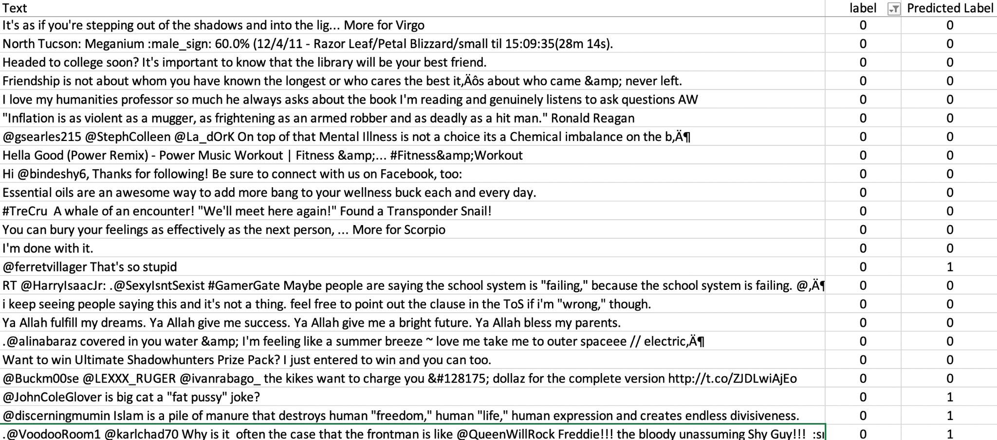
Non-Hate Actual & Predicted

Slide 23
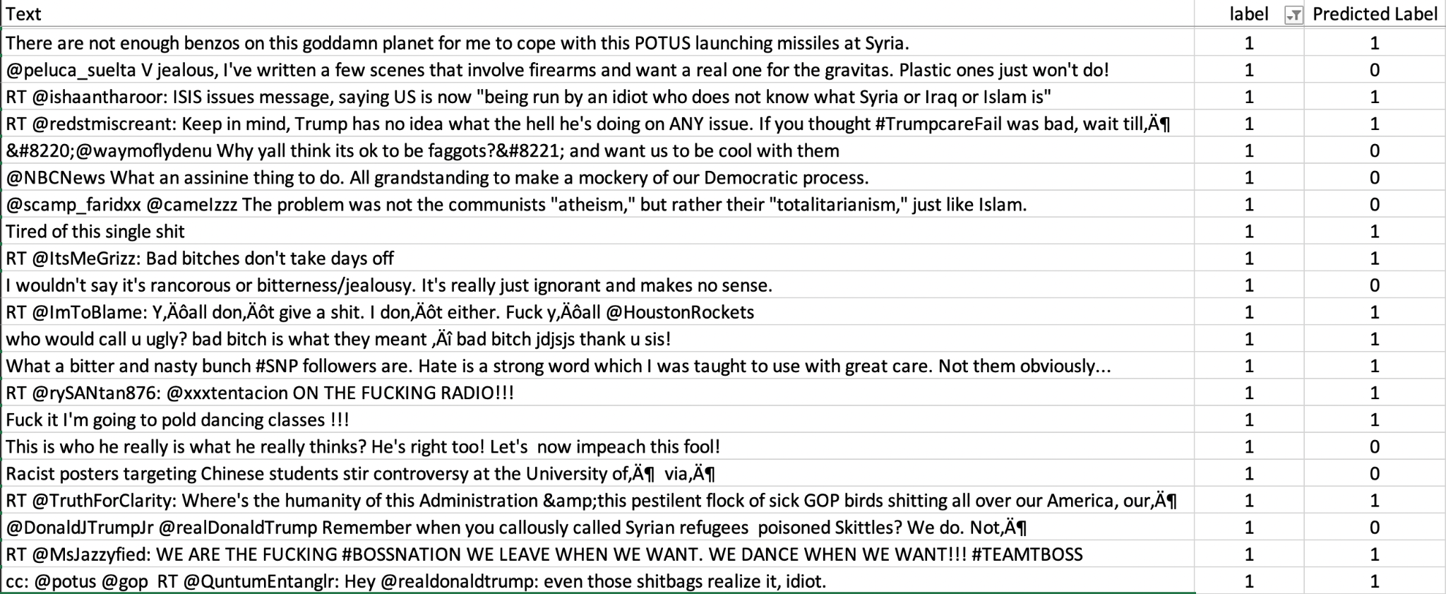
Hate Actual & Predicted

Slide 24
References
TF-IDF : https://www.analyticsvidhya.com/blog/2021/11/how-sklearns-tfidfvectorizer-calculates-tf-idf-values/
GLOVE: https://towardsdatascience.com/light-on-math-ml-intuitive-guide-to-understanding-glove-embeddings-b13b4f19c010
ELMO: https://medium.com/saarthi-ai/elmo-for-contextual-word-embedding-for-text-classification-24c9693b0045#:~:text=ELMo%20stands%20for%20Embeddings%20from%20Language%20Models%2C%20and,accurately%20guess%20the%20next%20word%20in%20the%20example.
BERT Contextual Embedding : https://arxiv.org/pdf/1805.06201v1.pdf
Back Translation : https://towardsdatascience.com/data-augmentation-in-nlp-using-back-translation-with-marianmt-a8939dfea50a
EDA : https://arxiv.org/pdf/1901.11196.pdf
Smote : https://towardsdatascience.com/imbalanced-classification-in-python-smote-enn-method-db5db06b8d50
BERT T5 : https://www.analyticsvidhya.com/blog/2021/12/text-classification-using-bert-and-tensorflow/#:~:text=BERT%20is%20a%20very%20good,a%20binary%20text%20classification%20task

